Slide 1
Vision–Language–Audio Perception System
for Assistive Scene Understanding
Neural Network and Deep Learning
Aayush Khanal
20049123

Slide 2
Problem Statement
2.2 billion people globally live with vision impairment.
Existing assistive systems rely on single-modality perception.
Limited environmental awareness reduces navigation safety.
Need for real-time multimodal environmental understanding.

Slide 3
Research Objective & Hypothesis
Research Question:
Can multimodal fusion improve assistive environmental understanding compared to vision-only systems?
Objectives:
Develop multimodal perception pipeline
Prioritize safety-critical objects
Convert fused output into structured audio guidance
Hypothesis:
Multimodal integration improves contextual awareness at computational cost.

Slide 4
System Architecture
Object Detection – YOLOv8
Scene Captioning – BLIP-2
Text Recognition – TrOCR
Information Fusion Layer
Text-to-Speech Audio Output
All modules operate sequentially to generate assistive feedback.

Slide 5
Dataset Composition
COCO Dataset (Filtered)
27 assistive-relevant object classes
Custom Road Sign Dataset
877 images
1,244 annotations
4 traffic-related classes
Final Split:
Train: 10,613 images
Validation: 383 images (2,194 instances)
Test: 333 images

Slide 6
Model Architecture – YOLOv8
YOLOv8s (Ultralytics)
11.1M parameters
28.5 GFLOPs
73 layers
Training Configuration:
100 epochs, batch size 32
Image size: 640x640
Optimizer: AdamW
Data augmentation: HSV, rotation, mosaic, mixup
Hardware: Tesla P100 GPU (16GB)

Slide 7
Experimental Setup
Software:
Python, PyTorch, Ultralytics
HuggingFace Transformers (BLIP-2, TrOCR)
Evaluation Metrics:
mAP@50
Precision
FPS
Inference latency (ms)
Evaluation: 50-image detection test & 20-image full pipeline test

Slide 8
Detection Performance
mAP@50: 50.3%
Precision: 57.8%
Average detections/image: 4.78
Detection-only Performance:
245 ms per image
4.1 FPS
Full Multimodal Pipeline:
1026 ms per image
0.97 FPS
Trade-off: Contextual richness vs computational speed

Slide 9
Ablation Analysis
YOLOv8 Only: 4.1 FPS – Object labels only
YOLO + Captioning: Reduced FPS – Adds scene context
Full Pipeline: 0.97 FPS – Complete multimodal guidance
Conclusion: Multimodal fusion increases contextual awareness while reducing speed.

Slide 10
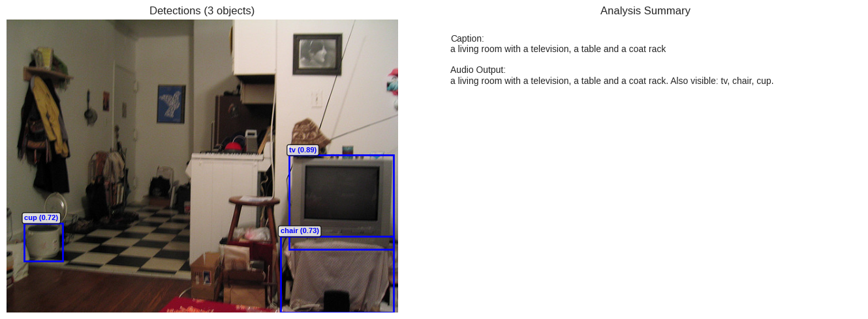
Multimodal Fusion & Audio Output

Slide 11
Limitations
Reduced FPS after multimodal fusion (0.97 FPS)
GPU-dependent for practical performance
Class imbalance in road sign dataset
Low-light performance not extensively evaluated
No temporal smoothing for real-time video

Slide 12
Contributions & Future Work
Contributions:
- Multimodal integration (Vision + Language + OCR + Audio)
- Assistive-focused dataset filtering
- Priority-based object alert system
Future Work:
- Model quantization & TensorRT optimization
- Real-time video processing
- Edge-device deployment (wearables)
- Multilingual support

Slide 13
Conclusion
Developed a multimodal assistive perception system.
Demonstrated contextual understanding beyond object detection.
Identified performance trade-offs in real-time deployment.
Provides foundation for practical assistive AI systems.

